Slide 1
Lecture 1 Multithreaded Programming

Slide 2
INTRODUCTION
Modern operating systems hold more than one activity (program) in memory and the processor can switch among all to execute them.
Multitasking/MultiProcesses: is the simultaneous occurrence of several activities (program) on a computer.
The operating system supports multitasking in a cooperative or preemptive manner.
For example,
you can open a fi le using MS Word and you can work on MS Access for creating your database.
Two applications are available in memory and the processor (by means of the operating system) switches to the application you are actively working on.

Slide 3
The operating system multitasking
The operating system supports multitasking in a cooperative or preemptive manner.
In cooperative multitasking each application is responsible for relinquishing control to the processor to enable it to execute the other application, as in earlier versions of operating systems.
In the preemptive type multitasking, the processor is responsible for executing each application in a certain amount of time called a time slice, as in modern operating systems.
A single processor computer is shared among multiple applications with preemptive multitasking, the processor is switching between the applications at intervals of milliseconds, you feel that all applications run concurrently.

Slide 4
Actually,
To have true multitasking, the applications run on a machine with multiple processors. Multitasking results in effective and simultaneous utilization of various system resources such as processors, disks, and printers.
As multitasking is managed by operating systems.
# We focus on learning how to write an application containing multiple tasks that can be executed concurrently. In Java, this is realized by using multithreading techniques.

Slide 5
Concepts Process and Thread
A process is a program in execution.
A process may be divided into a number of independent units known as threads.
A thread is a dispatchable unit of work.
Threads are light-weight processes within a process .
A process is a collection of one or more threads and associated system resources.
A process may have a number of threads in it. A thread may be assumed as a subset of a process.

Slide 6
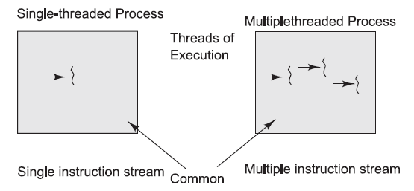
Process containing single and multiple threads

Slide 7
If two applications are run on a computer (MS Word, MS Access), two processes are created.
Multitasking of two or more processes is known as process-based multitasking.
Multitasking of two or more threads is known as thread-based multitasking.
The concept of multithreading in a programming language refers to thread-based multitasking.
Process-based multitasking is totally controlled by the operating system. But thread-based multitasking can be controlled by the programmer to some extent in a program.

Slide 8
Thread vs Process
A program in execution is often referred as process. A thread is a subset(part) of the process.
A process consists of multiple threads. A thread is a smallest part of the process that can execute concurrently with other parts(threads) of the process.
A process is sometime referred as task. A thread is often referred as lightweight process.
A process has its own address space. A thread uses the process’s address space and share it with the other threads of that process.

Slide 9
Thread vs Process
A thread can communicate with other thread (of the same process) directly by using methods like wait(), notify(), notifyAll(). A process can communicate with other process by using inter-process communication.
New threads are easily created. However the creation of new processes require duplication of the parent process.
Threads have control over the other threads of the same process. A process does not have control over the sibling process, it has control over its child processes only.

Slide 10
Context Switching
The concept of context switching is integral to threading.
A hardware timer is used by the processor to determine the end of the timeslice for each thread.
The timer signals at the end of the timeslice and in turn the processor saves all information required for the current thread onto a stack. Then the processor moves this information from the stack into a predefined data structure called a context structure.
When the processor wants to switch back to a previously executing thread, it transfers all the information from the context structure associated with the thread to the stack.

Slide 11
The advantages of thread-based multitasking as compared to process-based multitasking :
Threads share the same address space.
Context-switching between threads is normally inexpensive.
Communication between threads is normally inexpensive.
Java supports thread-based multitasking .

Slide 12
THREADS IN JAVA
Applications are typically divided into processes during the design phase, and a master process explicitly spawns sub-processes when it makes sense to logically separate significant application functionalities.
Processes are an architectural construct.
Thread is a coding construct that does not affect the architecture of an application.
A single process might contain multiple threads.
All threads within a process share the same state and same memory space, and can communicate with each other directly, because they share the same variables.

Slide 13
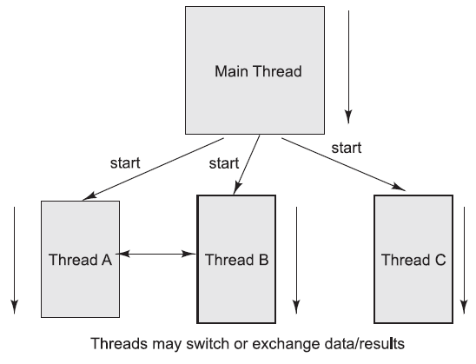
Program with master and children threads

Slide 14
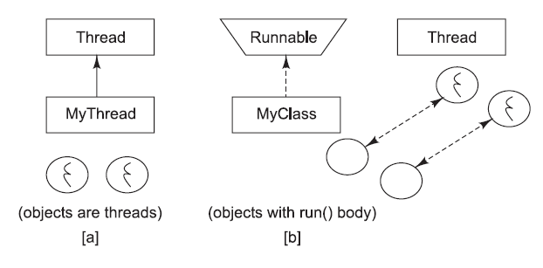
THREADS IN JAVA
Threads are objects in the Java language. They can be created by using two different mechanisms:
1. Create a class that extends the standard Thread class.
2. Create a class that implements the standard Runnable interface.

Slide 15
THREADS IN JAVA
Thread can be defined by:
Extending the java.lang.Thread class, or
Implementing the java.lang.Runnable interface.
The run() method should be overridden and should contain the code that will be executed by the new thread.
This method must be public with a void return type and should not take any arguments.

Slide 16
Extending the Thread Class
1. Create a class by extending the Thread class and override the run() method:
class MyThread extends Thread {
public void run() {
// thread body of execution
}
}
2. Create a thread object:
MyThread thr1 = new MyThread();
3. Start Execution of created thread:
thr1.start();

Slide 17
Example
/* ThreadEx1.java: A simple program creating and invoking a thread object by
extending the standard Thread class. */
class MyThread extends Thread {
public void run() {
System.out.println(“ this thread is running ... ”);
}
}
class ThreadEx1 {
public static void main(String [] args ) {
MyThread t = new MyThread();
t.start();
}
}

Slide 18
Implementing the Runnable Interface
1. Create a class that implements the interface Runnable and override run() method:
class MyThread implements Runnable {
…
public void run() {
// thread body of execution
}
}
2. Creating Object:
MyThread myObject = new MyThread();
3. Creating Thread Object:
Thread thr1 = new Thread(myObject);
4. Start Execution:
thr1.start();

Slide 19
Example
/* ThreadEx2.java: A simple program creating and invoking a thread object by
implementing Runnable interface. */
class MyThread implements Runnable {
public void run() {
System.out.println(“ this thread is running ... ”);
}
}
class ThreadEx2 {
public static void main(String [] args ) {
Thread t = new Thread(new MyThread());
t.start();
}
}

Slide 20
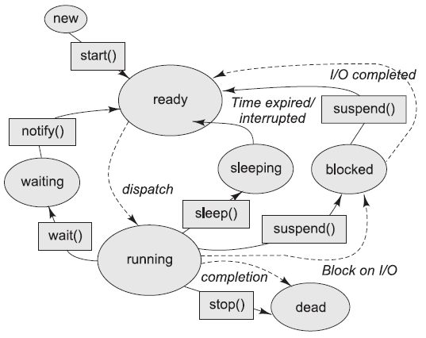
Life cycle of Java threads

Slide 21
Life Cycle of Thread
new
start()
I/O completed
ready
resume()
Time expired/ interrupted
notify()
sleeping
blocked
waiting
dispatch
sleep()
wait()
suspend()
running
Block on I/O
completion
stop()
dead

